Slide 1

Career development learning
AASMEE RAI

Slide 2
INTRODUCTION OF THE COMPANY
SummitX, a renowned company situated in Narephant, Kathmandu, is conveniently accessible via the main Koteshwor road. With over two decades of experience in the graphic design industry, SummitX has built a solid reputation for delivering high-quality and creative design solutions to international clients. The company is celebrated not only for its cutting-edge design projects but also for its dynamic and collaborative work culture that fosters creativity and growth.
During my internship at SummitX, I had the privilege of working alongside seasoned professionals who provided valuable mentorship and guidance. This experience allowed me to gain practical exposure to real-world projects, sharpen my technical and creative skills, and understand the industry's best practices. I also learned the importance of teamwork, communication, and attention to detail—skills that are essential for a successful career in the design and creative industry.

Slide 3

POSITION AND ROLE IN THE COMPANY
I worked as a Frontend Intern specializing in mobile app development using Flutter
Working alongside experienced professionals helped me understand industry standards, agile development practices, and the importance of effective teamwork and communication in delivering high-quality applications.

Slide 4
LEARNING OUTCOMES

Slide 5
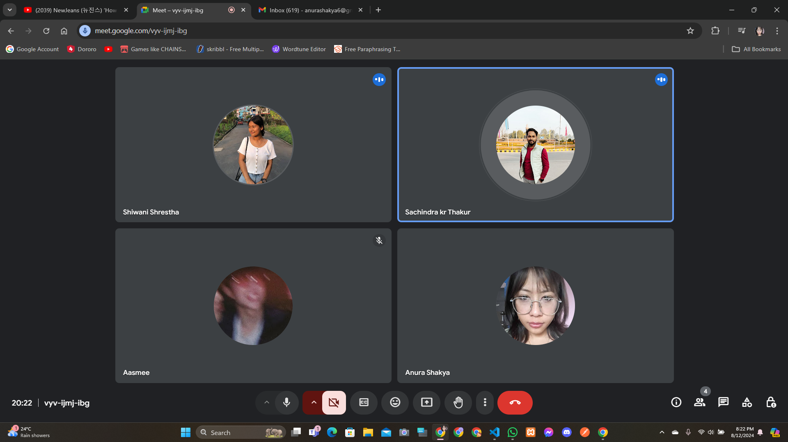
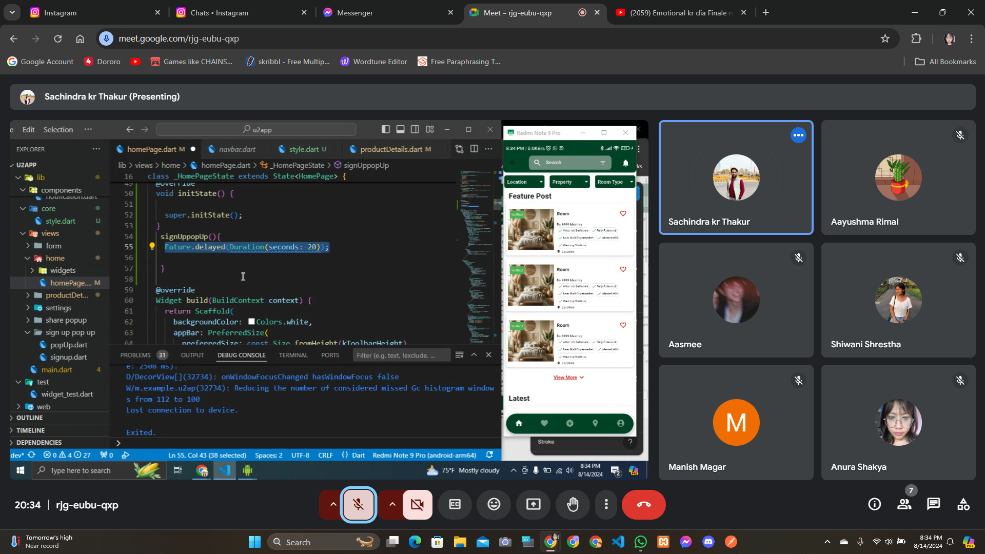
communication

Slide 6
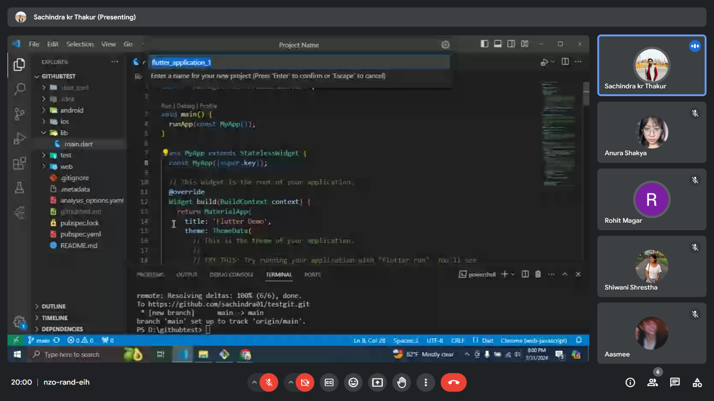
Team work

Slide 7
TIME MANAGEMENT
Time management is important, especially in the context of your internship and frontend development work. Here are some steps that helped me manage time during my internship-
Set Clear Daily Goals
Allocated Time for Learning and Practice
Followed Team Deadlines
Broke Down Complex Tasks
Asked for Help When Needed

Slide 8
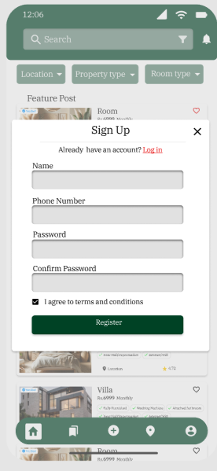
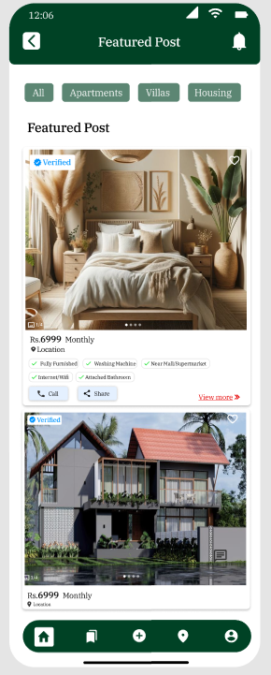
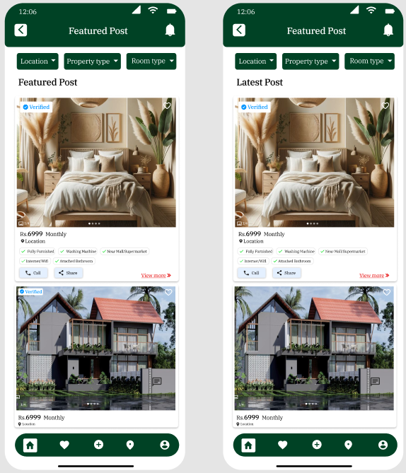
FIGMA
Figma was used to create wireframes, design high-fidelity mockups, develop responsive app layouts, collaborate with the team for feedback, and export assets to support the Flutter frontend development.

Slide 9
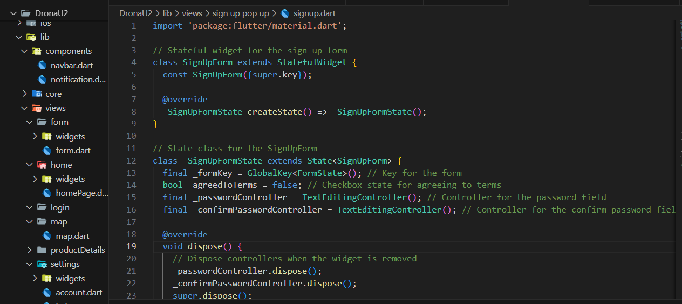
FRONTEND
Developed user-friendly and responsive app interfaces using Flutter, implemented UI designs from Figma, integrated APIs, and collaborated closely with the team

Slide 10
BACKEND
worked on the backend using Node.js to build and maintain APIs, handle database interactions, implement authentication, and ensure seamless communication between the frontend and server.

Slide 11
Challenges Encountered
Learning Curve with Flutter Framework
State Management Complexities
UI Responsiveness Across Devices
Debugging and Error Handling
UI/UX Design Implementation

Slide 12

WHAT I ENJOYED
As a frontend developer during my internship, I truly enjoyed the creative and technical aspects of designing and developing the app using Flutter. I found it exciting to transform design ideas into real, interactive user interfaces that were both functional and visually appealing. Working with Flutter allowed me to build beautiful cross-platform apps with a single codebase, which made the development process efficient and enjoyable. I particularly liked implementing animations, customizing UI components, and ensuring a smooth user experience across different devices.
Bringing Designs to Life:
Creative Freedom:
Collaboration with Designers and Developers:
Seeing the Final Product:

Slide 13
Future Career plan
Pursue a career as a Frontend Developer.
improving skills in UI/UX design,
Gain experience by working on larger, real-world projects to strengthen technical and problem-solving abilities.
Stay updated with industry trends and best practices through continuous learning and personal projects.

Slide 14
THANK YOU

